Slide 1

React.Js karkasas
Dėstytojas
Ernestas Rutkauskas
2 LYGIS
4 DALIS
Įvadas į React.Js karkasą

Slide 2
Šiandien išmoksite
React.Js karkasas
01
Refs
02
Context

Slide 3
Refs
React.Js karkasas
“Refs” - suteikia galimybę pasiekti DOM mazgus arba „React“ elementus, sukurtus pateikimo (render) metodu.
Kada naudoti Refs:
Managing focus, text selection, or media playback.
Triggering imperative animations.
Integrating with third-party DOM libraries.

Slide 4
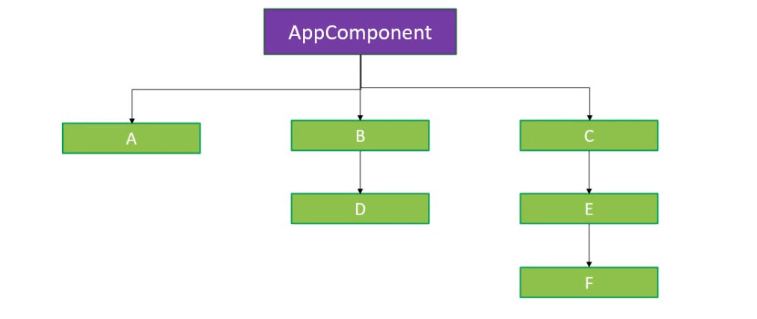
React Hooks
React.Js karkasas
“useContext” hook

Slide 5
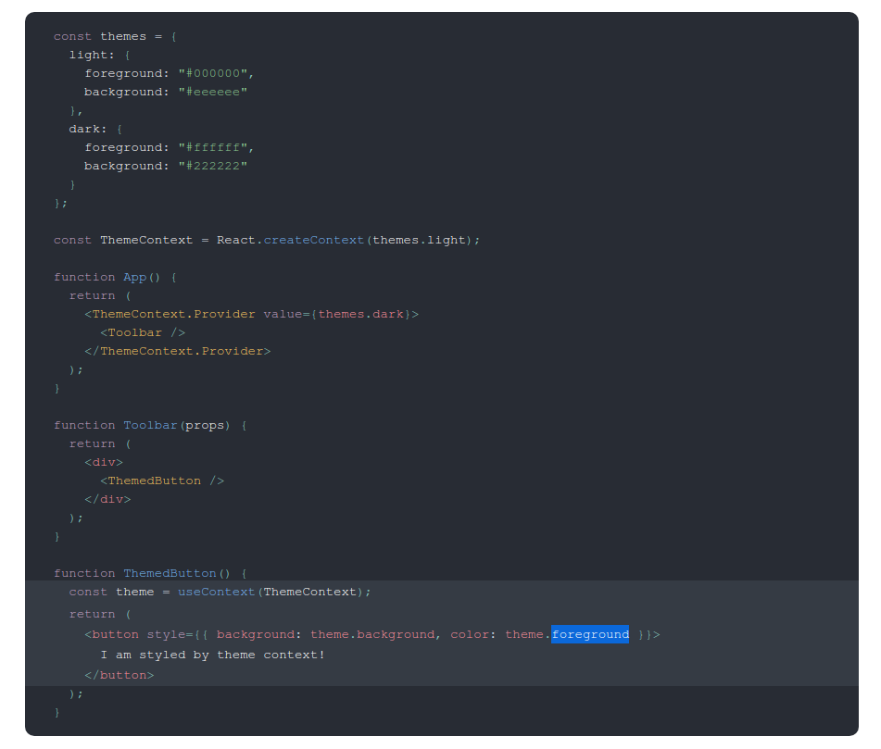
React Hooks
React.Js karkasas
“useContext” hook

Slide 6
Naudinga informacija
Prezentacijos pavadinimas
React Hooks
https://reactjs.org/docs/hooks-intro.html
React.js komponentai
https://reactjs.org/docs/components-and-props.html
https://reactjs.org/docs/react-component.html
React.js ir JSX
https://reactjs.org/docs/introducing-jsx.html
React.js Props and State
https://reactjs.org/docs/components-and-props.html
https://reactjs.org/docs/typechecking-with-proptypes.html
https://reactjs.org/docs/react-without-es6.html#declaring-default-props
https://reactjs.org/docs/state-and-lifecycle.html

